Slide 1

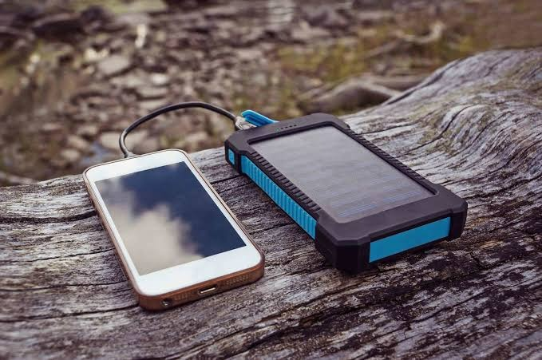
solar power bank

Slide 2
Pbl project on Solar power bank
Presented BY:- guided by:-
1)KARTHAVYA NIMBALKAR – FH07 prof. nipin kk sir
2)ADITYA BAMANE - FH10
3)Rajkumar nainala – FH15 BACHELOR OF ENGINEERING
4)Pratham vyas – fh16 FE-2021-2022
5)Mahesh raut – fh17 DR.D.Y.PATIL INSTITUTE OF
6)Suryansh sarawat – fh18 TECHNOLOGY,PIMPRI.

Slide 3
CONTENTS:-
INTRODUCTION
OBJECTIVES
SPECIFICATIONS
COMPONENTS
CIRCUIT DIAGRAM
METHODOLOGY
PROTOTYPE
ADVANTAGES
CONCLUSION AND FUTURE SCOPE
REFERENCE

Slide 4
Introduction
The major liability or drawbacks of communication lines comes because of the distortion of electrical lines or lack of generation of electricity as like in remote areas or during disaster or natural calamities. To set back such drawbacks, we need a renewable source of energy which can function round the clock without any disruption. Solar power bank is one of its kind. It works on the power of the sun, converting solar to electrical and helps in charging the cell phones which can be used in communication, and thus, turns to be vital during disasters and power outage.

Slide 5
OBJECTIVES:-
TO STUDY THE BASIC OPERATIONS OF A SOLAR MOBILE CHARGER
TO KNOW THE ADVANTAGES AND LIMITATIONS OF ITS USE
TO KNOW THE FUTURE SCOPE OF THE SOLAR MOBILR CHARGER
MAXIMIZING THE USE OF IT IN DAY-TO-DAY- LIFE

Slide 6
Specifications:-
1)SOLAR PANEL :– 6V, 250MA
2)BATTERIES:– 6000MAH, 3.7V LITHIUM ION
3)POWER BANK MODULE:- 4.5V, 500 MA
4)DIODE
5)RESISTOR:- 1.2 KOHM
6)LED

Slide 7
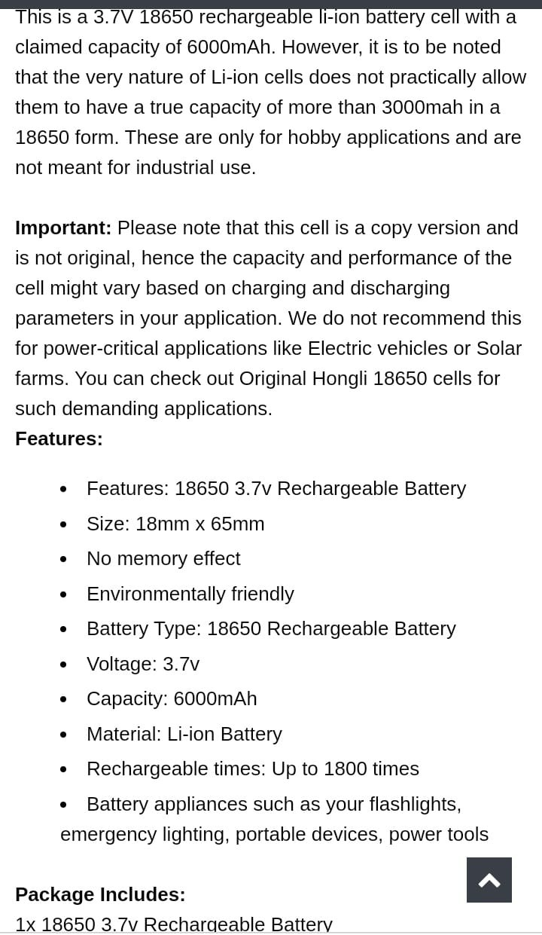
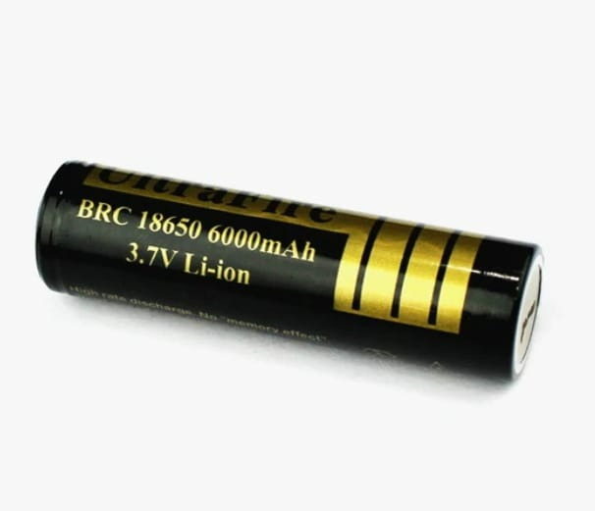
Components:- DC Battery:-

Slide 8
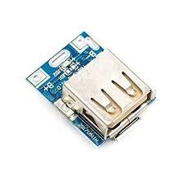
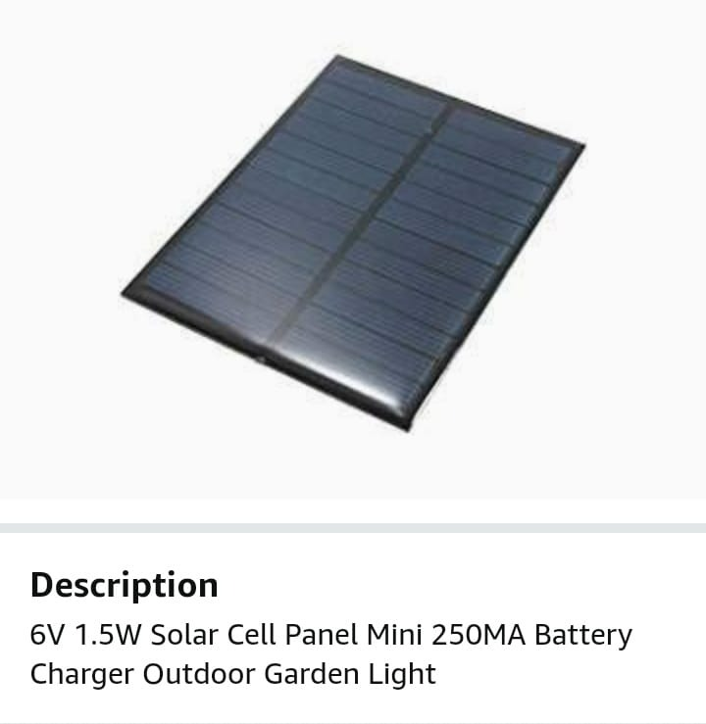
Power Bank Module:-
Solar Panel:-
Power Bank Module is a super mini power bank mainboard compatible with 3.7V-4.2V li-ion battery.
Solar panel are those devices which are used to absorb the sun's rays to convert them into electricity or heat.

Slide 9
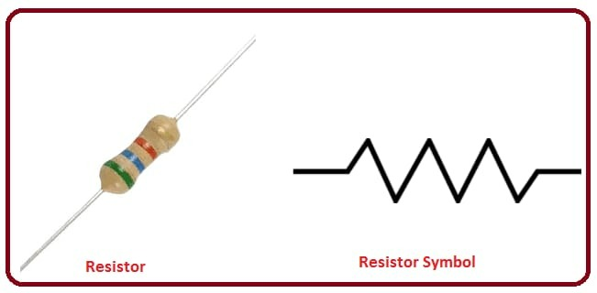
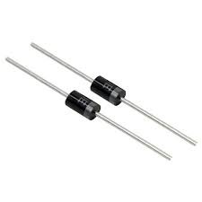
Diode
Diode:-
Diode is an electrical component that allows the flow of current in only one direction.
Resistor:-
A resistor is a passive two-terminal electrical component that implements electrical resistance as a circuit element

Slide 10
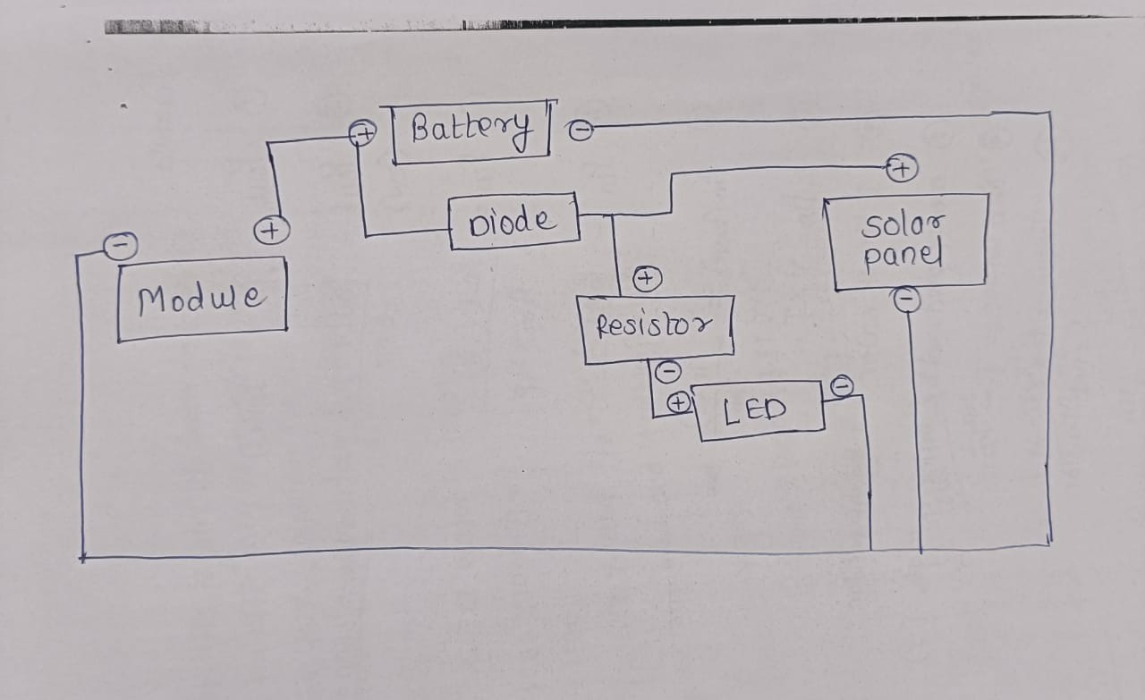
CIRCUIT DIAGRAM

Slide 11
Methodology
There are 2 main things to consider choosing a Solar panel or creating a Solar system. Battery capacity is measured in Amp Hours. The AH figure must be multiplied by the battery voltage to convert this to Watt Hours which is given by the simple calculation below.
X +Y = Z …(1)
where, Y = Battery Voltage
Z = Power available in watt hours
X =Battery size in AH.
However, as we know that we will not be able to power the battery once the voltage drops below our equipment’s 150 American Journal of Electrical and Electronic Engineering requirements, that is why, we are never really able to take all the power from a battery. Lead acid batteries will give around 50% of their rated power and Li-ion batteries will give around 80% of their rated power. Solar panels are the most critical and final part in designing solar panels. The generation of power in a solar panel is measured in Watts (e.g. The power generation of part number STP010 in a solar cell is 10W).Theoretically, the energy that can be supplied to a battery can be calculated by multiplying the power generation rating of the solar panel (measured in Watts) to the number of hours the panel is exposed to sunshine.

Slide 12
A photovoltaic module can be defined as an assembly of 6x10 solar cells connected and packaged together. The solar array of a photovoltaic system which is generally comprised of these photovoltaic cells generate solar electricity and is used in domestic applications. Under standard test conditions, the DC output power of each module ranges between 100 to 365 watts. If the rated output of a solar panel remains the same, the efficiency is determined by the area of the module .i.e. A 16% efficient 230 W solar module will consume half the area as that of a 8% efficient 230W module. Only a few solar panels exceed an efficiency of over 19%. Most installations contain multiple modules as a single solar module generates only a limited amount of power. Some of the typical examples of photovoltaic systems are an array of solar modules, a solar inverter, a battery, a solar tracker and interconnection wiring. The photovoltaic panels present in solar-charged power banks can trickle-charge the internal battery of the system when placed in direct sunlight. Depending on the capacity of the Power Bank and its current level of charge, it can take quite a while to fill up. For example, the time taken by a smartphone to charge completely is same as the time taken to charge a 1500mAh power bank completely. For larger banks, this charging time can be doubled, tripled or quadrupled. Most Power Banks use LED indicators to show whether these power banks are at capacity and a safety cut-off valve to avoid overheating and overcharging.

Slide 13
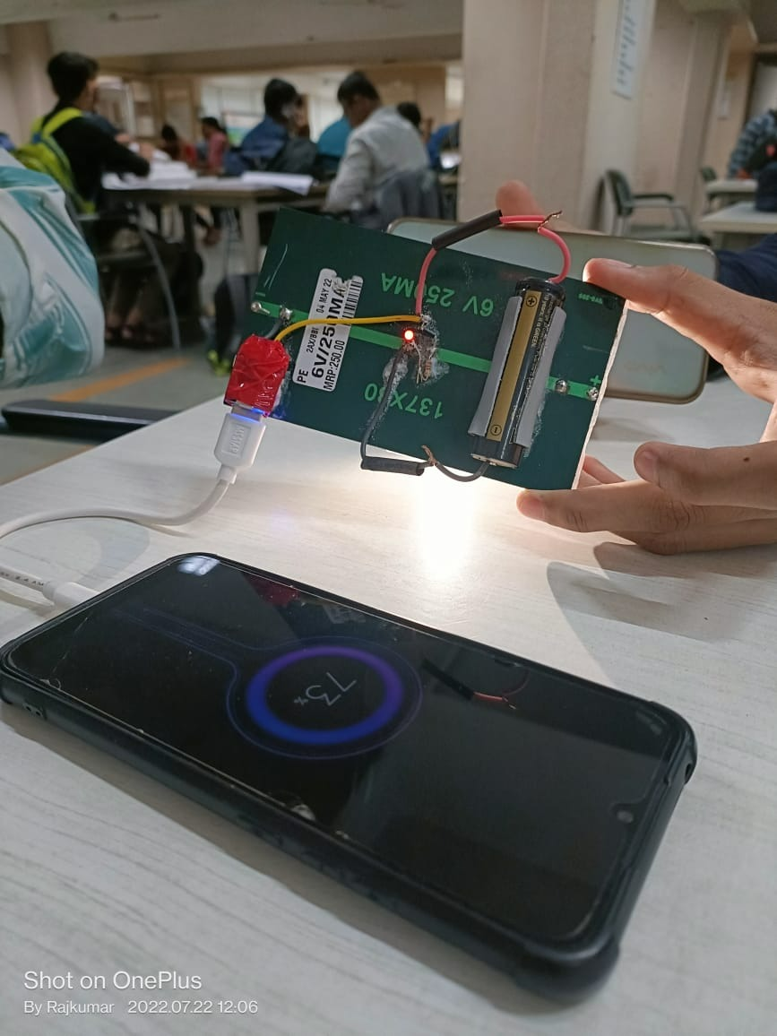
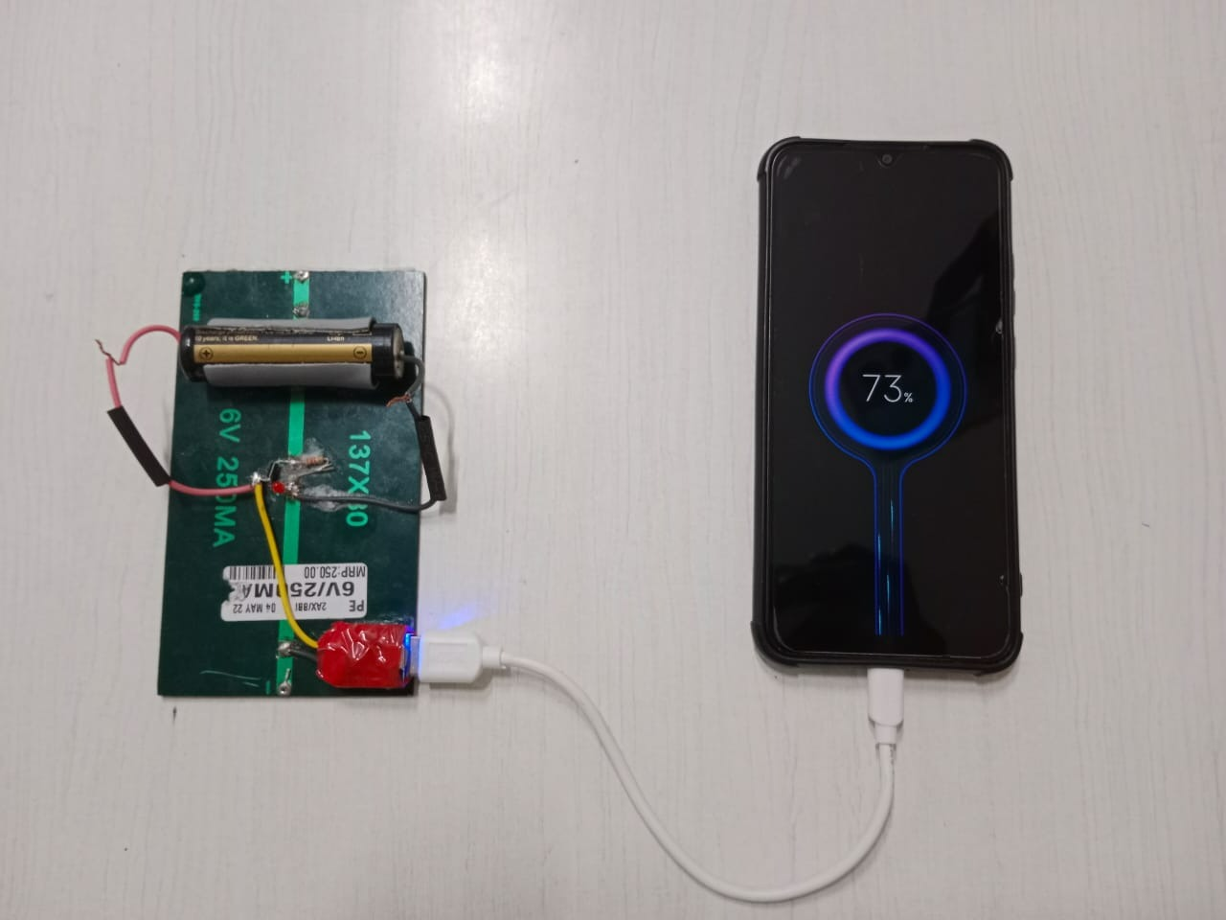
Prototype

Slide 14
Advantages
In this presentation, the product proposed meets the following requirements.
is compact and lightweight to conserve resources;
achieves the top levels of energy conservation performance;
manages hazardous chemical substances
is easily recycled at the end of life;
Parts reuse/recyclability, disassembly/dismantling
Sustainably uses the renewable resources
Minimises the use of number of interconnecting wires or cables

Slide 15
Conclusion & future scope
We have chosen two solar panels instead of one to make it more portable and handy. A relay circuit has been added to improve the safety of the circuit, battery and the mobile phone. If the phone is undercharged or overcharged, the relay will cut the supply saving the battery and mobile from getting damaged. We have improvised the battery with an indicator integrated with a microcontroller which gives indication about the battery percentage.

Slide 16
Refrences
Ke Liu, John Makaran, “Design of a solar powered battery charger”, Electrical Power & Energy Conference (EPEC), 2009 IEEE, 2009, pp. 1-5.
Sangyoung Park, Bumkyu Koh, Yanzhi Wang; Jaemin Kim, Younghyun Kim, Massoud Pedram, Naehyuck Chang,“Maximum power transfer tracking in a solar USB charger for smartphones”, Low Power Electronics and Design (ISLPED), 2013 IEEE International Symposium, pp. 88-93.
Kevin Otto & Kristin Wood, Product Design –Techniques in Reverse Engineering and New Product Development, 4th ed. Noida (U.P): Pearson Education, 2014, pp. 51-409.
K.Jaiganesh, K.Duraiswamy, “Dump Power Control Techniques for standalone Hybrid Wind / Solar Power Generation Control”, 2012 - International Conference on Emerging Trends in Science, Engineering and Technology, pp. 422-428.
AtmelAVR. Wikipedia. Retrieved 12 February, 2016, from https://en.wikipedia.org/wiki/Atmel_AVR.

Slide 17
Thank you

